Slide 1
Risk Management and Software Testing

Slide 2
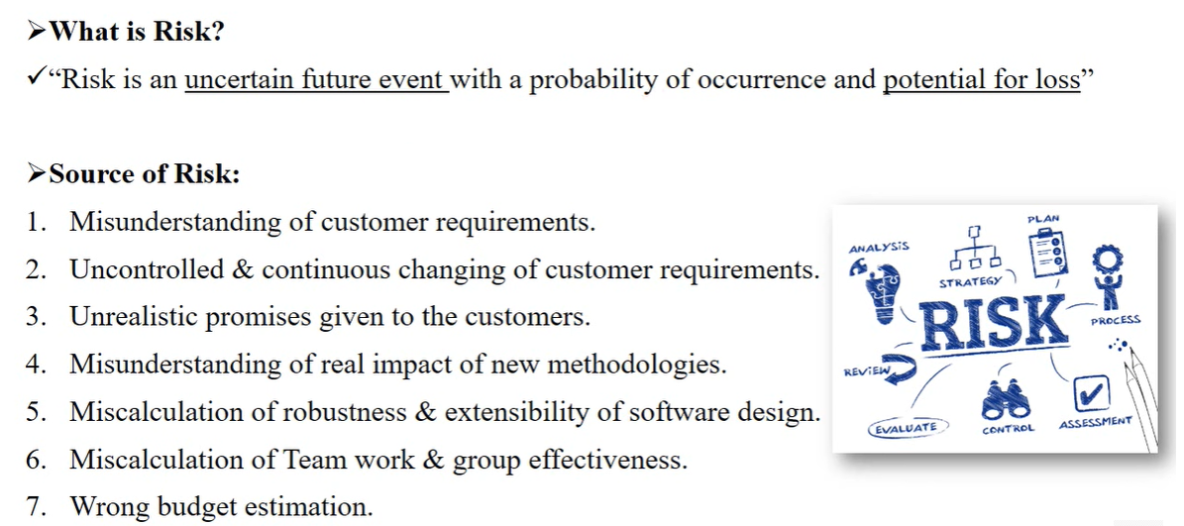
Source of Risk

Slide 3
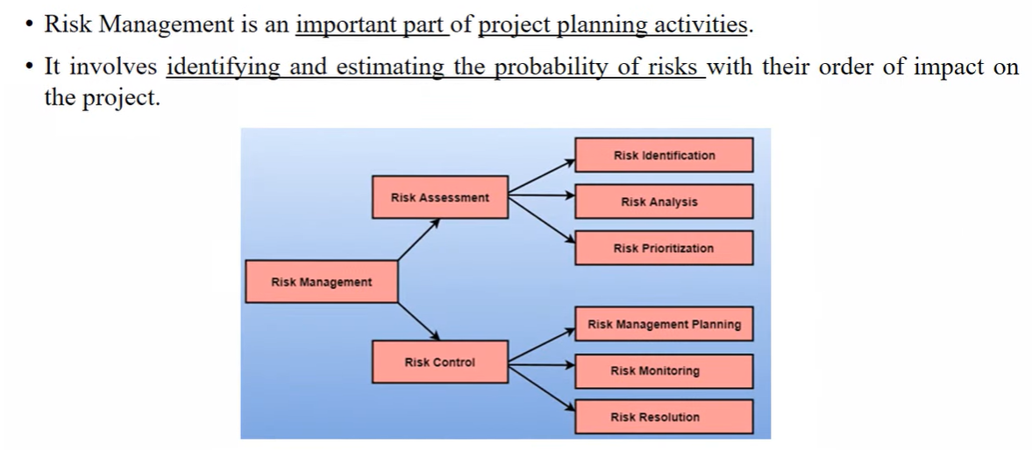
Risk Management

Slide 4
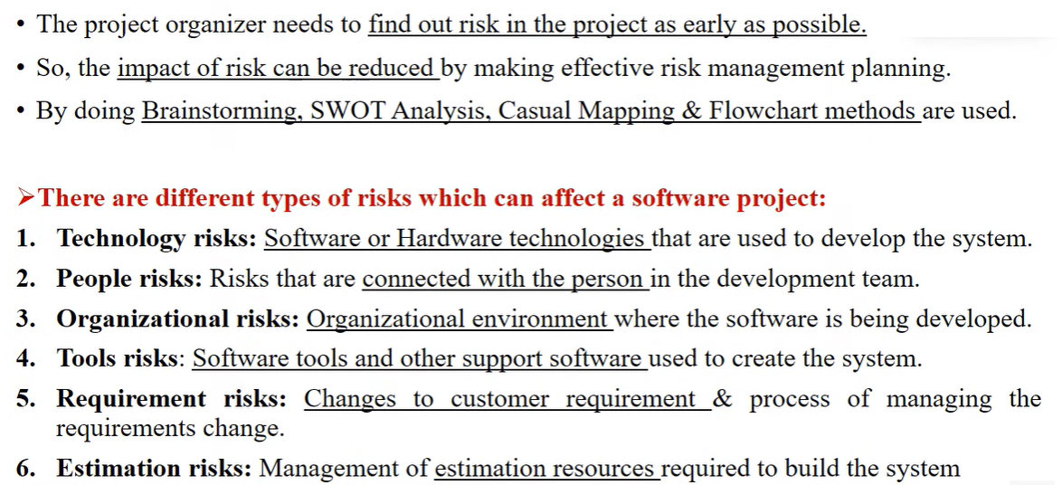
Risk Identification

Slide 5
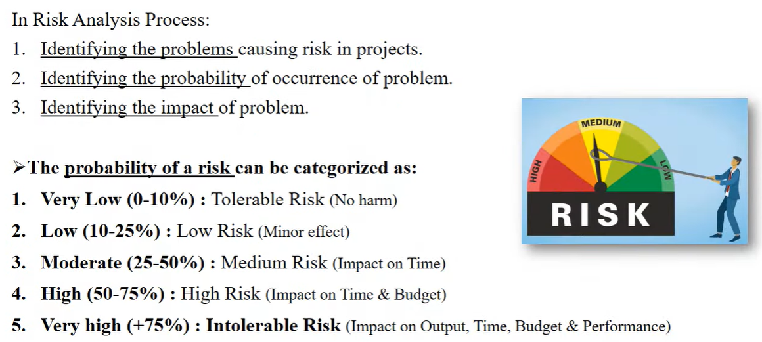
Risk Analysis and Projection (or Prioritization)

Slide 6
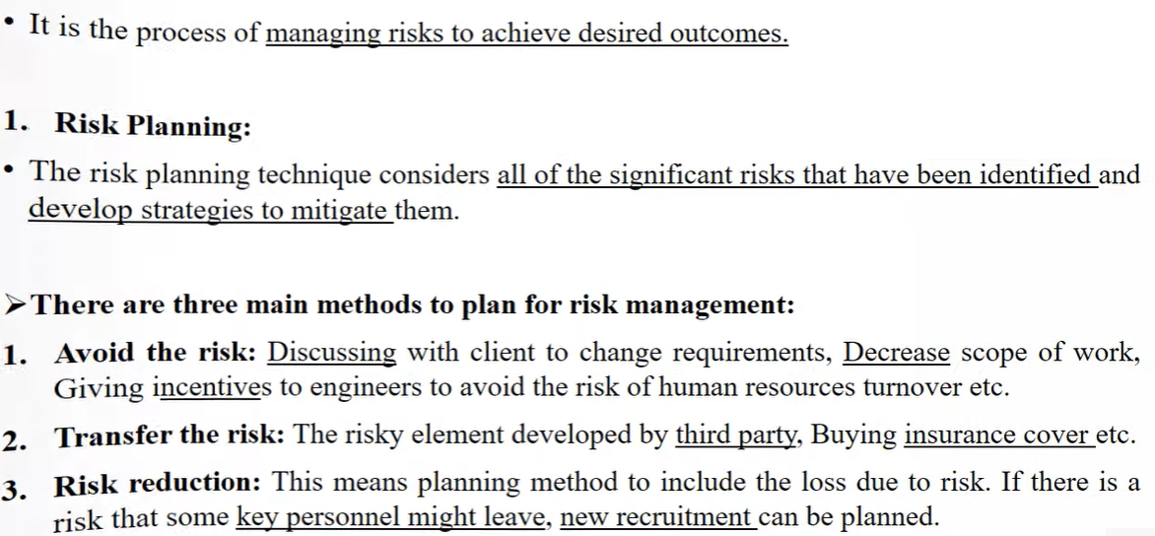
Risk Control

Slide 7
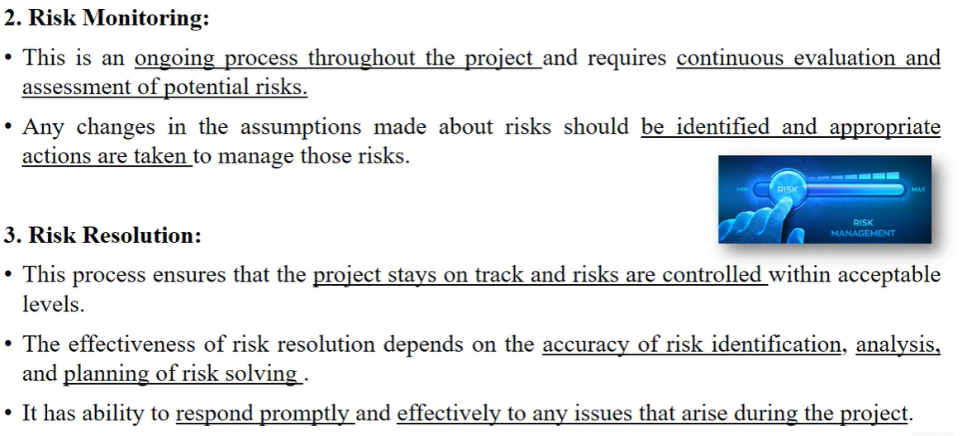
Contd…

Slide 8
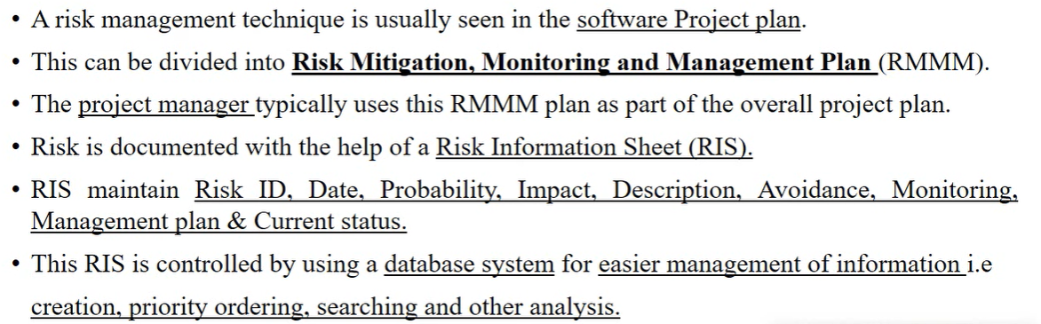
RMMM Plan

Slide 9
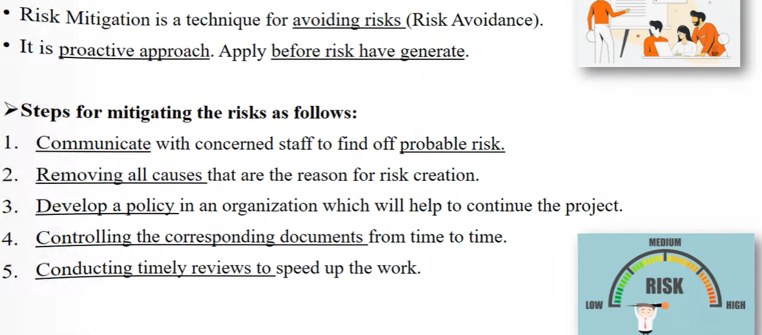
Risk Mitigation

Slide 10
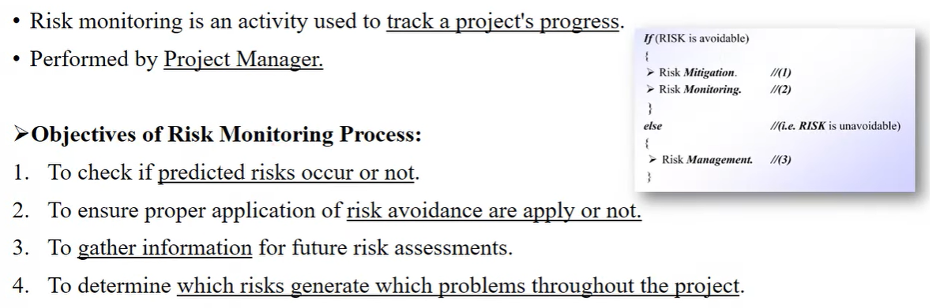
Risk Monitoring

Slide 11
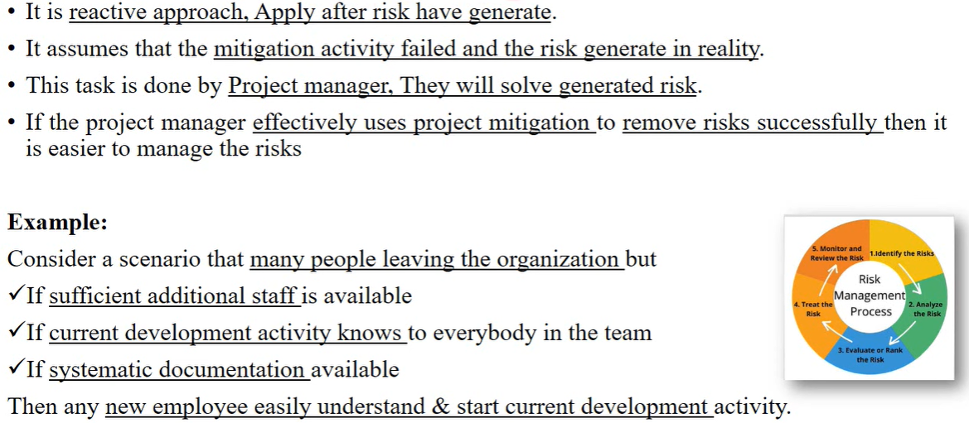
Risk Management

Slide 12
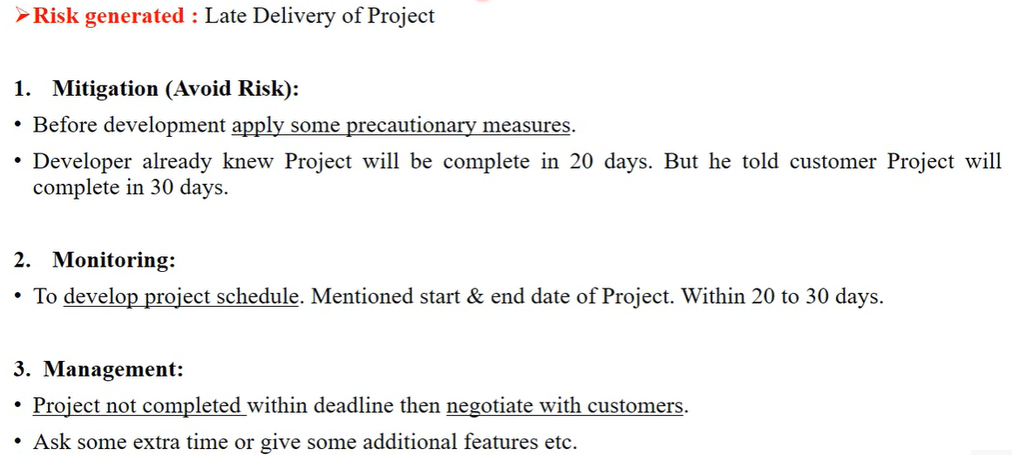
RMMM Plan - Example

Slide 13
Drawbacks of RMMM
It incurs additional project costs.
It takes additional time.
For larger projects, implementing an RMMM may itself turn out to be another tedious project.
RMMM does not guarantee a risk-free project, infact, risks may also come up after the project is delivered.

